Slide 1

Online Retail Database System
Presented By:
"Padedham, Ms. Akhila" <ap72332n@pace.edu>
"Vanka, Ms. Srija" <sv90712n@pace.edu>
"Pothineni, Mr. Harsha" <hp82069n@pace.edu>
"Nadar, Mr. Jegan" <jn44669n@pace.edu>
"Chirakala, Mr. Purna Chandu" <pc73275n@pace.edu>

Slide 2
Online Retail Database System
The Online Retail Database System enhances e-commerce operations by addressing challenges like extensive product ranges, diverse vendor networks, and digitally inclined consumers.
It handles various data categories, including product listings, user profiles, purchase records, and inventory statuses, making it a critical resource for e-commerce success.
The system emphasizes interconnectedness, instant accessibility, and adaptability, ensuring smooth communication between consumers, vendors, and managers.
It uses cutting-edge database architecture methods and the entity-relationship model to maintain data uniformity and precision, simplifying inquiries and analytics.
The system is flexible, scalable, and capable of handling spikes in consumer activity, new products, and increased transaction frequencies, making it essential for thriving e-commerce businesses.

Slide 3
Business rules
Uniqueness: Each element has a unique identifier.
Product Listing: Sellers list products within one category at a time.
Order Specificity: Orders link to a specific customer and may contain multiple products.
Review Traceability: Reviews are linked to specific products and buyers.
Seller-Customer Interaction: Sellers respond to buyers who've ordered or inquired.
Product Attributes: Complete product info is required.
Transaction Completeness: Confirmed transactions include order details.
Inquiry Responsiveness: Timely responses to inquiries are crucial.
Shipping Consistency: Shipped orders have shipment records.
Customer Account Validity: Complete accounts are needed for ordering.
Stock Availability: Products reflect current stock status; out-of-stock items can't be ordered

Slide 4
ENTITY RELATIONAL MODEL
An ER (Entity-Relationship) diagram is a visual representation of the data model that depicts the relationships among entities in a database. It is a graphical tool used in database design to illustrate the structure of a database and the relationships between different entities within that database.
In an ER diagram, entities are represented by rectangles, and the relationships between entities are depicted by connecting lines. Each entity typically corresponds to a table in the database, and the attributes of the entity are represented within the rectangle. The relationships, shown by lines connecting entities, define how the data in one table relates to the data in another.
There are different types of relationships, such as one-to-one, one-to-many, and many-to-many, which are indicated by various symbols and connecting lines. The ER diagram provides a clear and concise way to communicate the database schema, helping both developers and stakeholders understand the structure of the database and how data entities are related to each other.

Slide 5
Customer
ID, Name, Email, Password, Address, Phone
Places (Order), Submits (Review), Makes (Inquiry)
Seller
ID, StoreName, Contact, lists (Product)
Product
ID, Name, Price, CategoryID, SellerID, Stock
Belongs_to (Category), Listed_by (Seller), Included_in (OrderDetail), Reviewed (Review)
Category
ID, CategoryName, has (Product)
Order
ID, CustomerID, Date, Status
Placed_by (Customer), Contains (OrderDetail), Has (Transaction), Sent_via (Shipment)
OrderDetail
ID, OrderID, ProductID, Quantity
Details_of (Order), Includes (Product)
Transaction
ID, OrderID, Amount, Date, Payment
Belongs_to (Order)

Slide 6
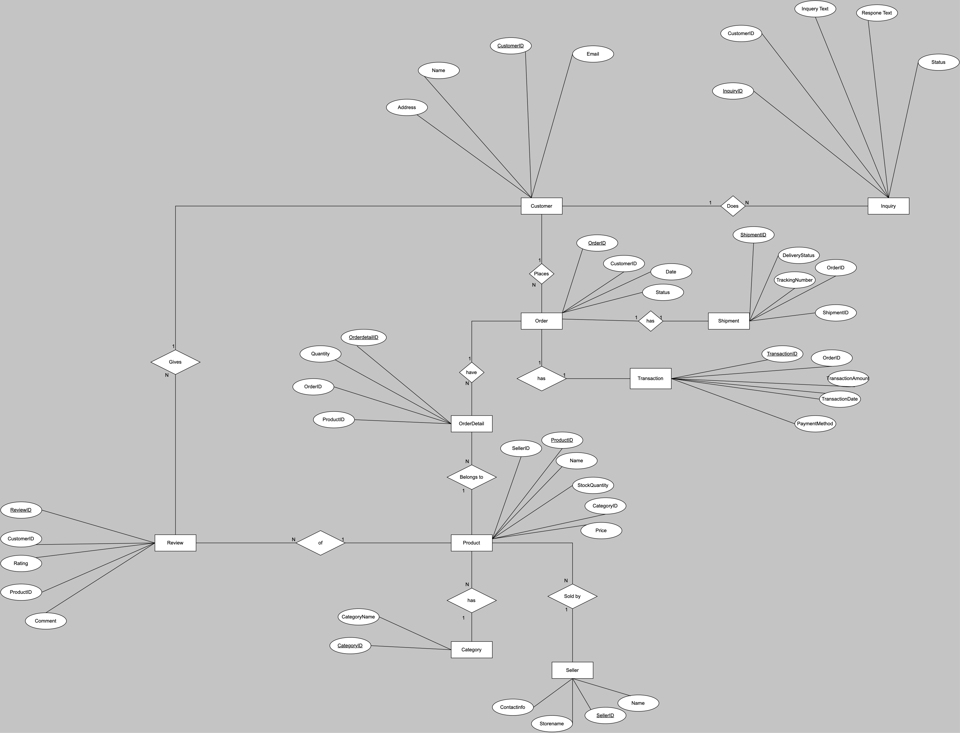
Review
ID, ProductID, CustomerID, Rating, Comment
Given_by (Customer), For (Product)
Inquiry
ID, CustomerID, InquiryText, ResponseText, Status
Made_by (Customer)
Shipment
ID, OrderID,Date, TrackingNumber, Status
Pertains_to (Order)

Slide 7
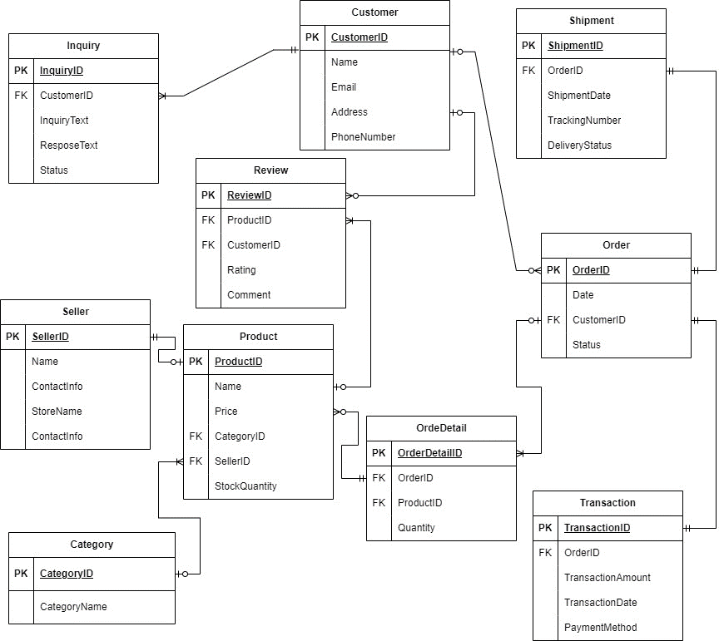
DATABASE SCHEMA
A database schema is a way to logically organize and structure the data and its relationships in a database management system (DBMS). It defines the blueprint for how data is stored, accessed, and managed within a database.
A database schema typically includes:
1. Tables
2. Columns and Data Types
3. Constraints
4. Relationships
$. Indexes
6. Views
7. Stored procedures and Triggers
8. Security

Slide 8
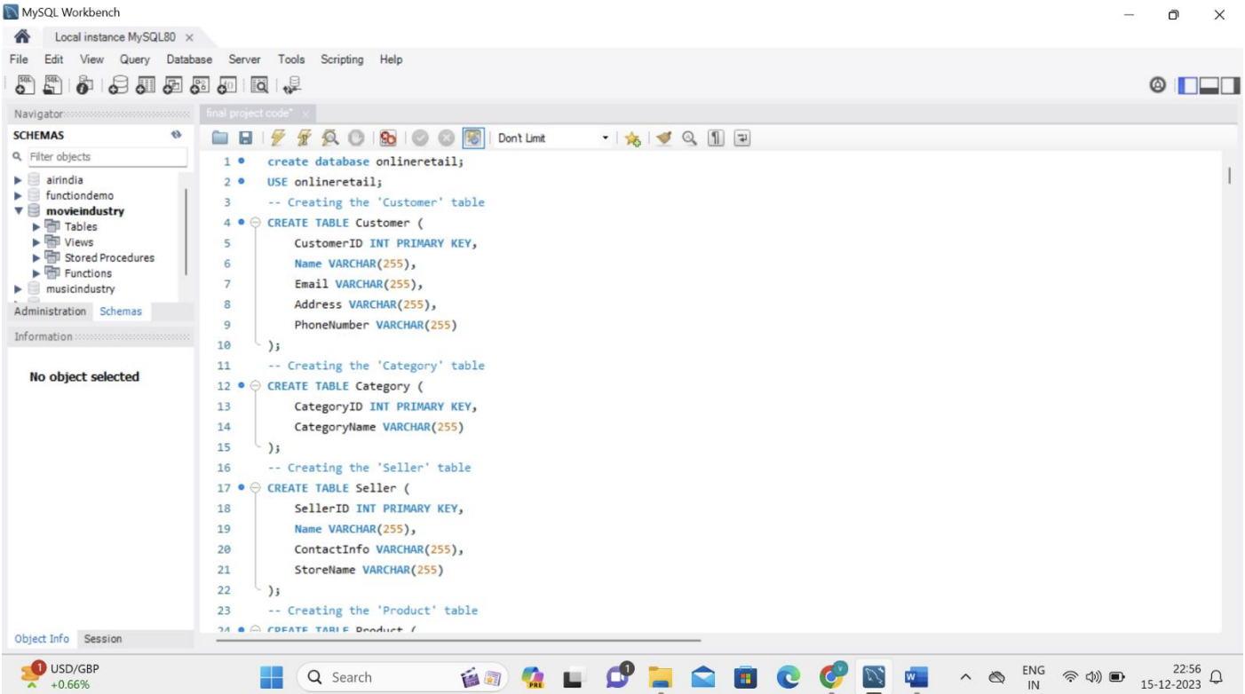
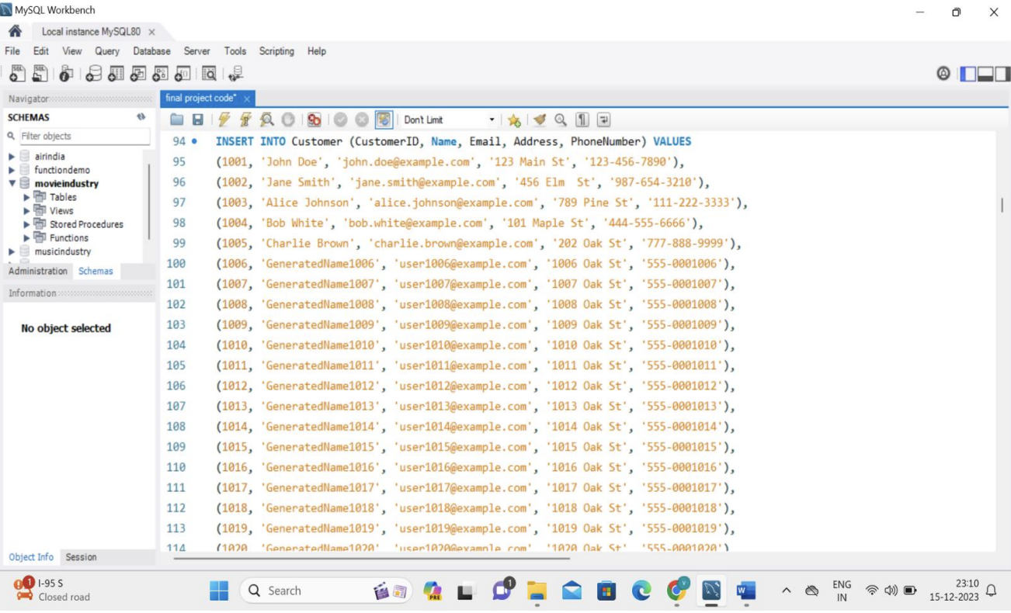
Creating tables and inserting values:
SQL provides the CREATE TABLE statement to create a new table in a given database. An SQL query to create a table must define the structure of a table
The SQL INSERT INTO Statement is used to add new rows of data into a table in the database.

Slide 9
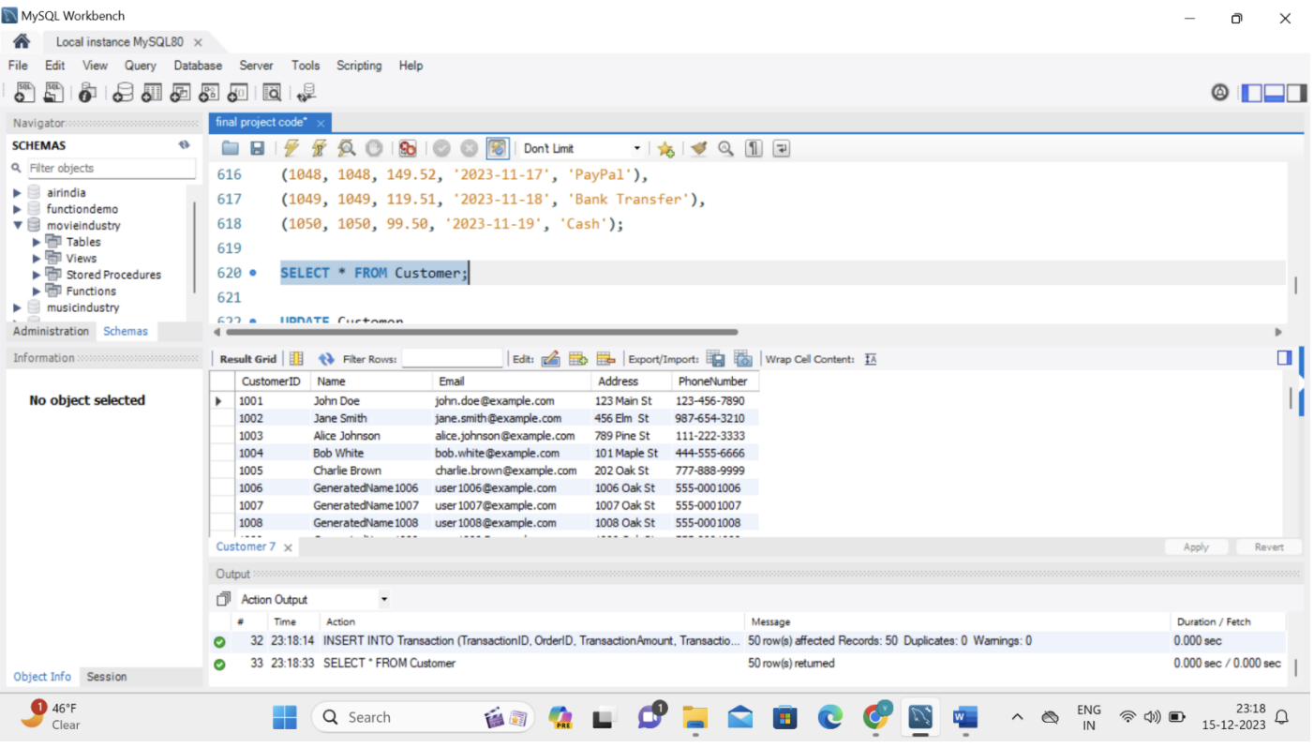
Select statement:
The SELECT statement is used to select data from a database.

Slide 10
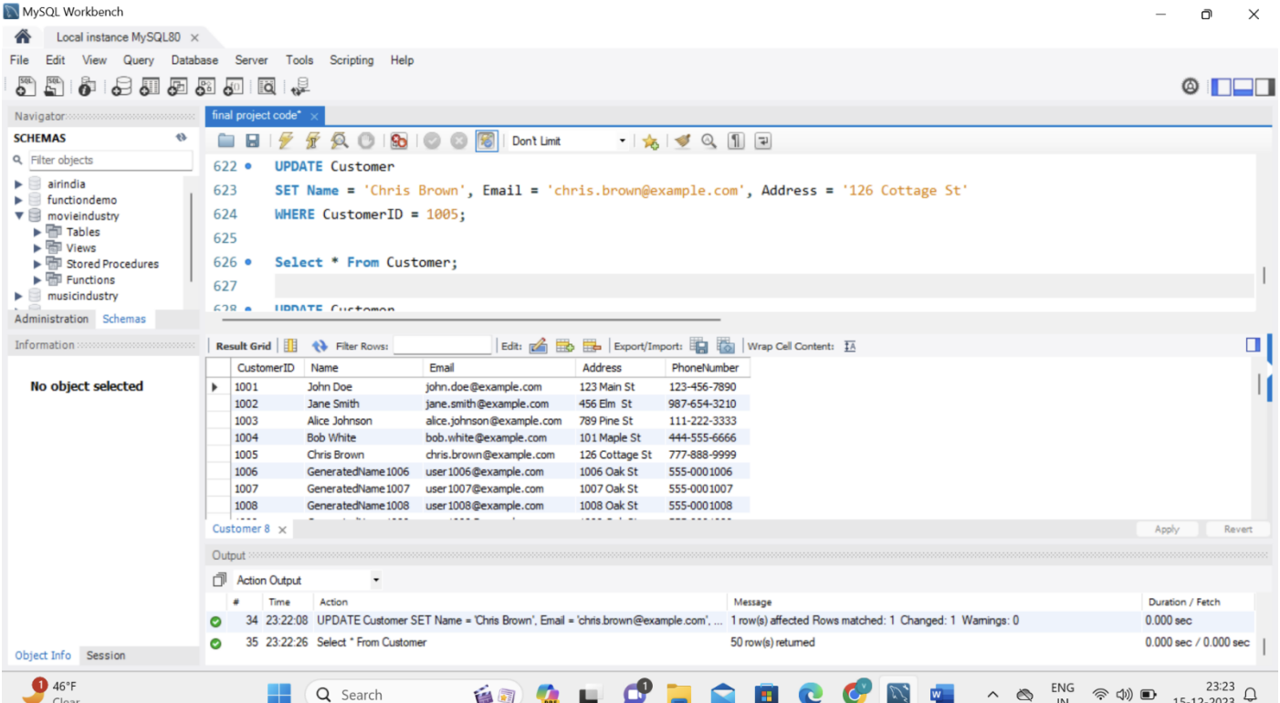
Update:
The UPDATE statement is used to modify the existing records in a table.

Slide 11
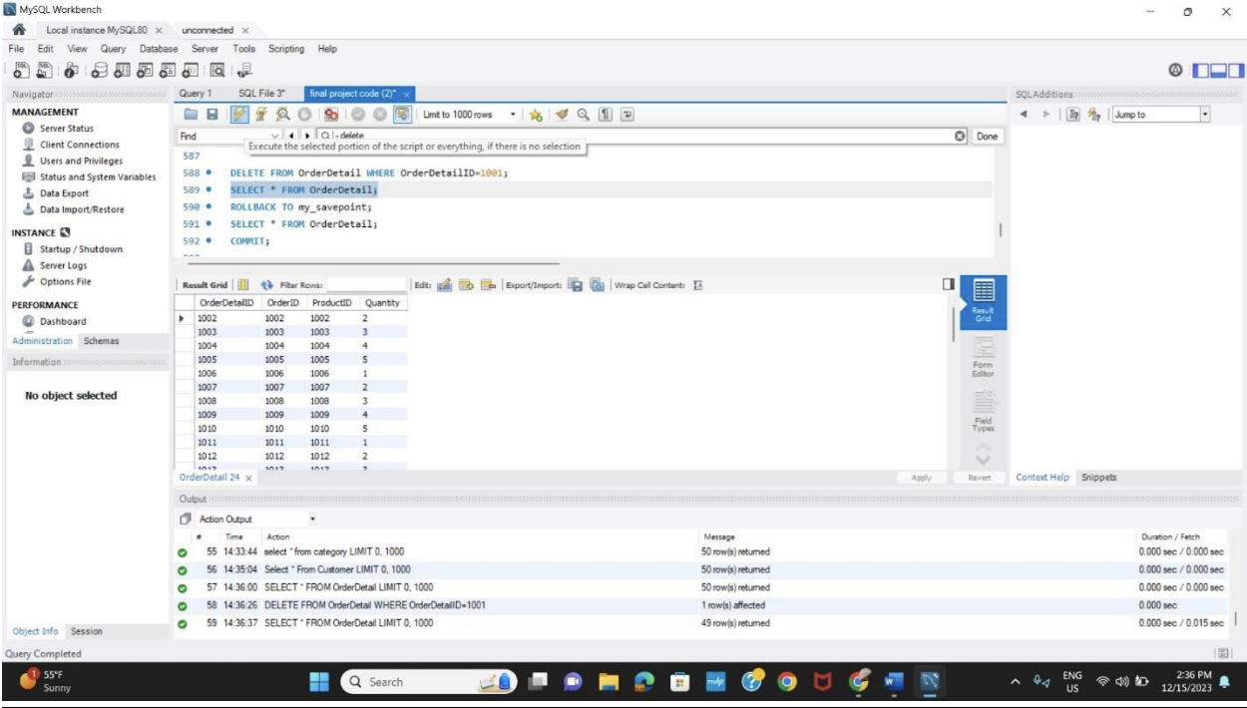
Delete:
The DELETE statement is used to delete existing records in a table.

Slide 12
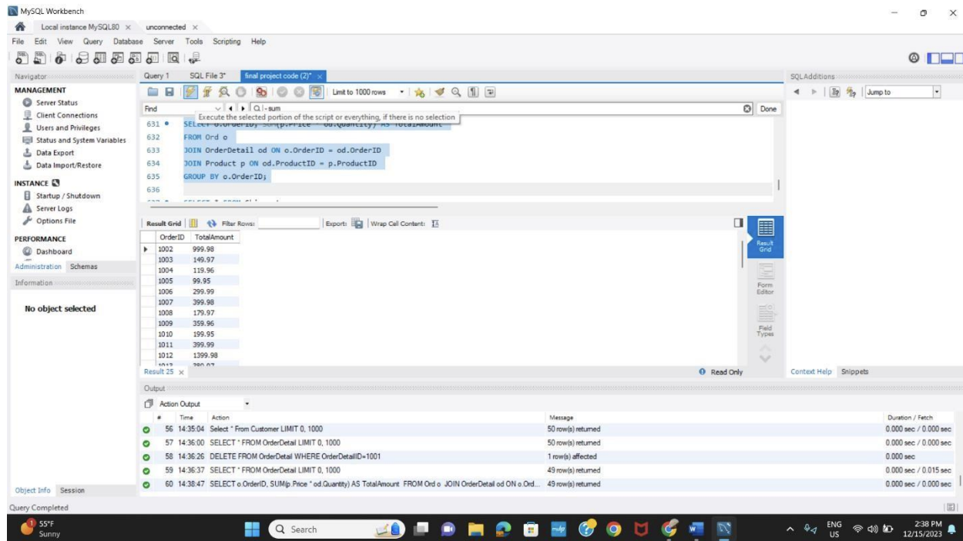
Aggregate Function(SUM):
The SUM() function returns the total sum of a numeric column.

Slide 13
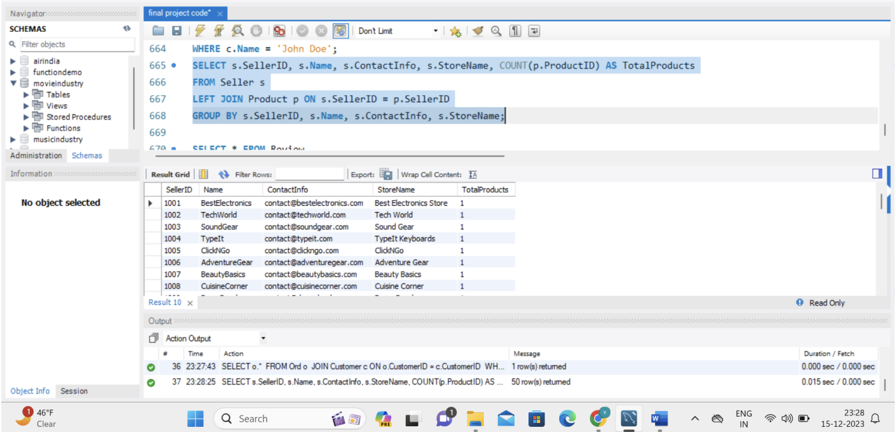
Joins:
The LEFT JOIN keyword returns all records from the left table (table1), and the matching records (if any) from the right table (table2).

Slide 14
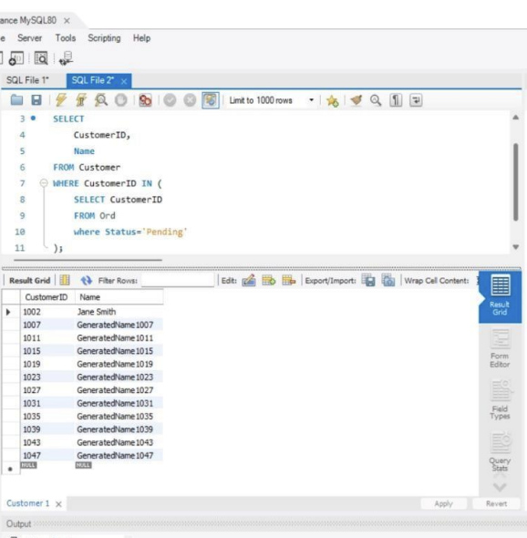
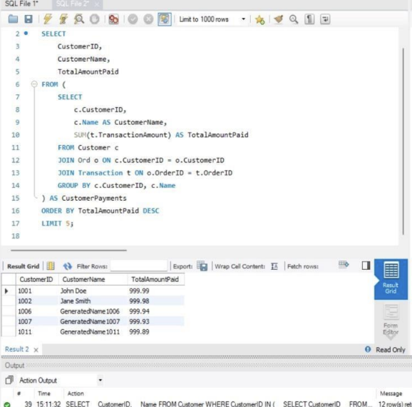
Subquery(Nested query):
An SQL Subquery, is a SELECT query within another query. It is also known as Inner query or Nested query and the query containing it is the outer query.

Slide 15
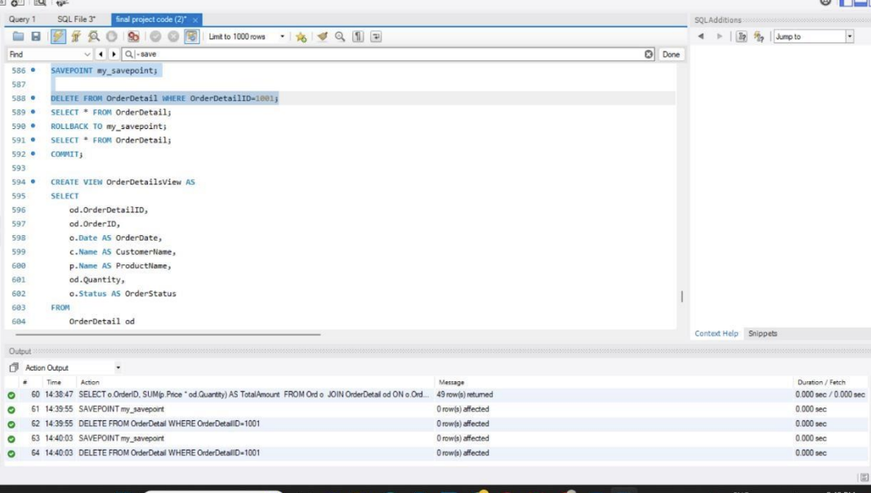
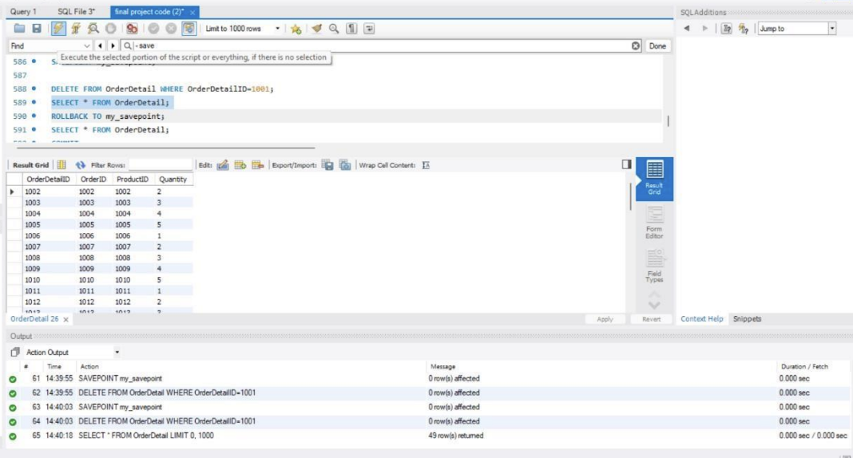
Savepoint:
A savepoint is a point within a transaction where you can set a marker to which you can later roll back. It allows you to create a point in the transaction process to which you can return if needed. Savepoints are useful in scenarios where you want to make partial changes within a transaction and have the ability to undo those changes selectively.

Slide 16
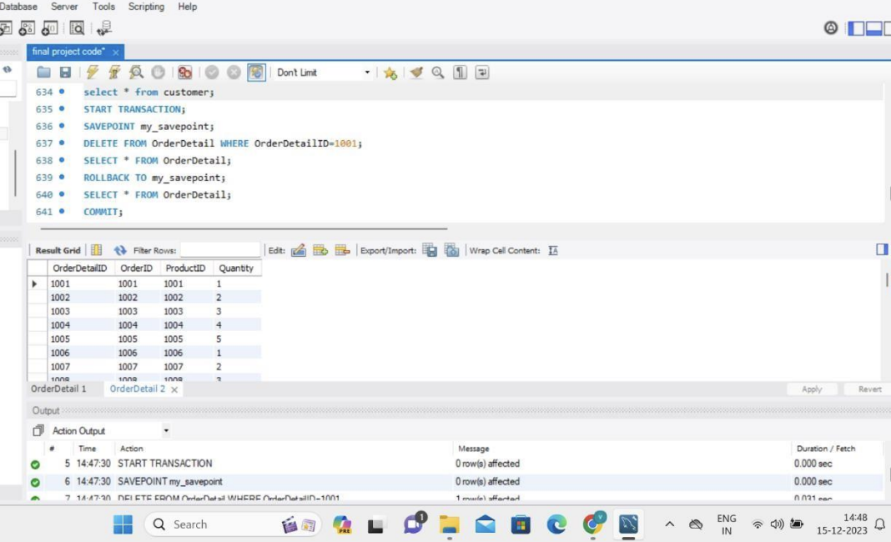
Rollback:
A rollback is an operation that undoes or cancels the effects of one or more transactions, returning the system to a previous state. It is used to revert changes made during a transaction, either entirely or up to a specified savepoint.

Slide 17
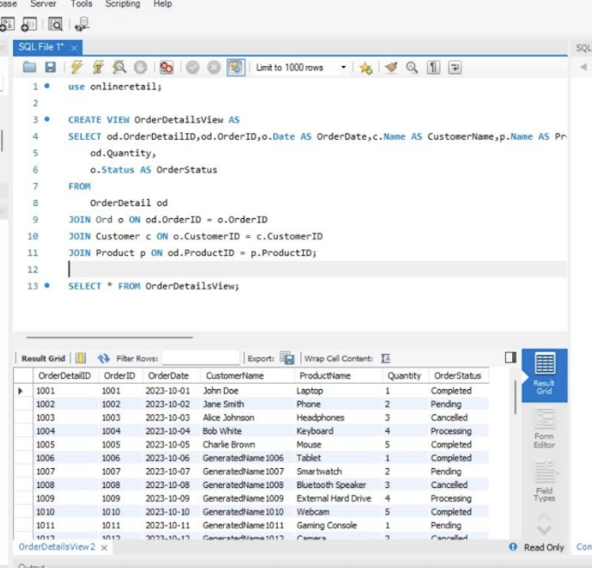
Views:
A view in SQL is a virtual table that is stored in the database with an associated name. It is actually a composition of a table in the form of a predefined SQL query. A view can contain rows from an existing table (all or selected). A view can be created from one or many tables. Unless indexed, a view does not exist in a database.

Slide 18
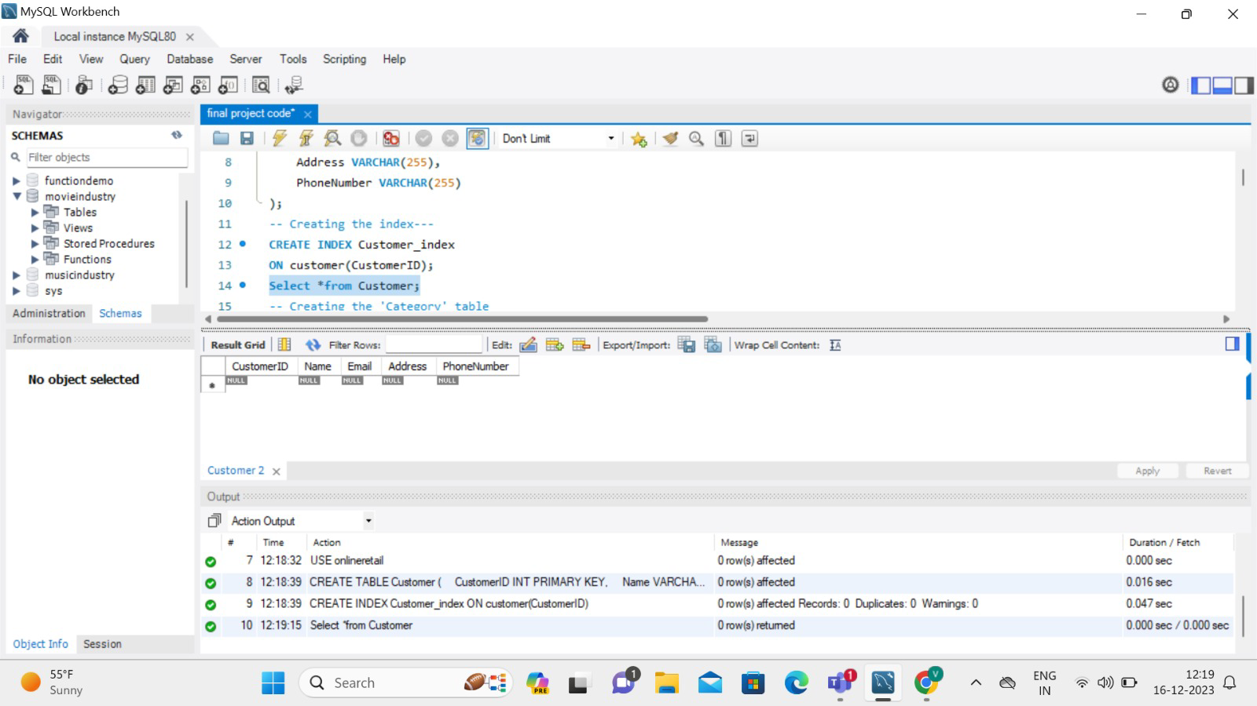
INDEXING:
The CREATE INDEX statement is used to create indexes in tables.
Indexes are used to retrieve data from the database more quickly than otherwise.
The users cannot see the indexes, they are just used to speed up searches/queries.

Slide 19
Security Measures
Secure Sockets Layer (SSL) Encryption: Implement SSL encryption to secure data transmitted between clients (web browsers) and the online retail system. This prevents unauthorized interception of sensitive information during transactions.
User Authentication and Authorization: Use strong authentication mechanisms for user logins, such as username/password combinations or multi-factor authentication (MFA).
Payment Card Industry Data Security Standard (PCI DSS) Compliance: If the online retail system handles credit card transactions, ensure compliance with PCI DSS standards. This includes secure storage of cardholder data, encryption, access controls, and regular security assessments.
Data Encryption: Encrypt sensitive data, both in transit and at rest. Utilize encryption mechanisms provided by the database system to protect customer information stored in the database.
Regular Security Audits and Monitoring: Conduct regular security audits and monitoring of the online retail system. This includes reviewing logs for unusual activities, monitoring system performance, and identifying potential security incidents.
Secure Coding Practices: Follow secure coding practices to prevent common web application vulnerabilities, such as SQL injection, cross-site scripting (XSS), and cross-site request forgery (CSRF). Regularly update and patch web application frameworks and libraries.

Slide 20
Conclusion
The Online Retail Database System is a sophisticated infrastructure vital for modern e-commerce, designed to handle diverse data types and facilitate seamless interactions between consumers, vendors, and managers. It employs advanced database architecture and the entity-relationship model, ensuring data precision and offering valuable insights for strategic decision-making. This system is not only adaptable and scalable, but it also adheres to stringent business rules, enhancing transaction efficiency and customer satisfaction. In essence, it's a crucial tool for e- commerce businesses, driving them towards success and customer approval in a rapidly evolving digital marketplace.

